Slide 1
Installation Guide to Communications Toolbox R2025a
McMaster Automotive Resource Centre (MARC)

Slide 2
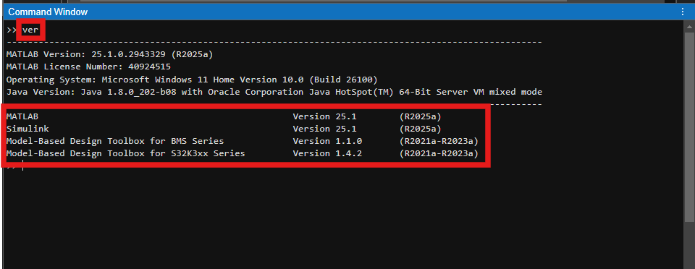
Installation Guide to Communications Toolbox in MATLAB R2025a
1. First, check if the Communications Toolbox is installed by typing ver in the Command Window and pressing Enter. If it’s not listed, follow the steps on the next page to install it.

Slide 3
Installation Guide to Communications Toolbox in MATLAB R2025a
2. Go to the Home tab.

Slide 4
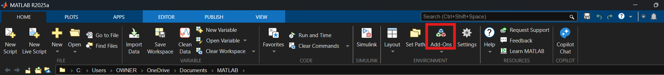
Installation Guide to Communications Toolbox in MATLAB R2025a
3. Click Add-Ons.

Slide 5
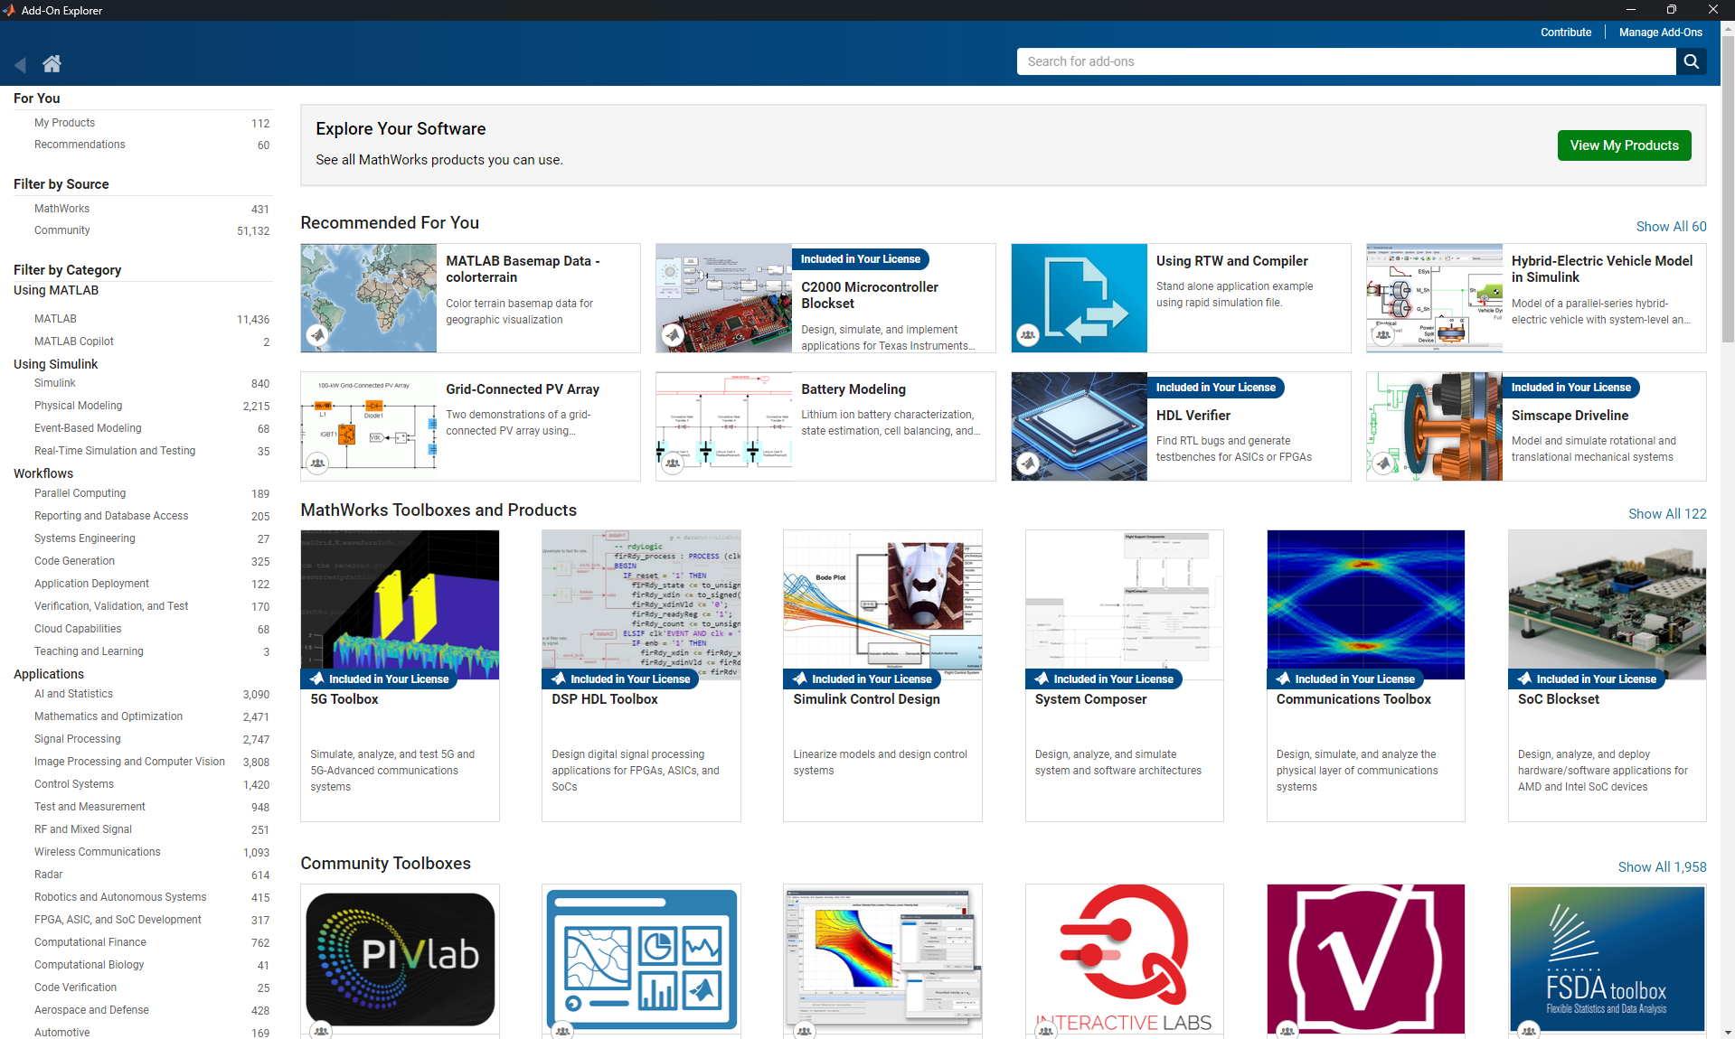
Installation Guide to Communications Toolbox in MATLAB R2025a
4. Add-on Explorer pop-up window should appear.

Slide 6
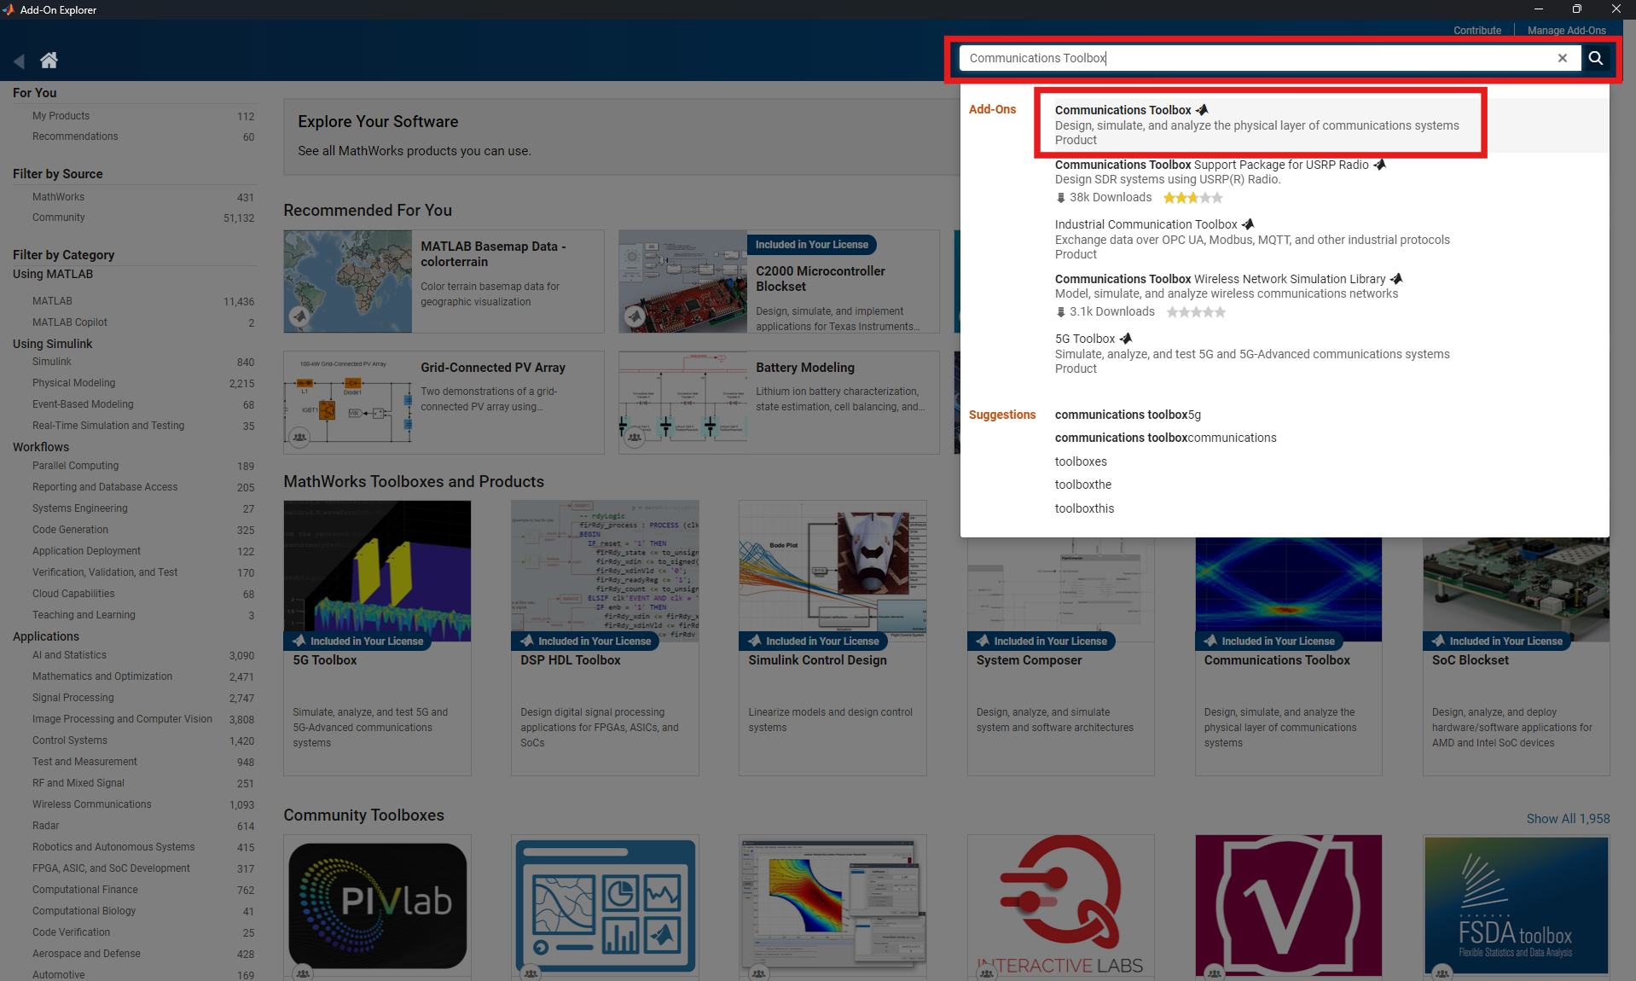
Installation Guide to Communications Toolbox in MATLAB R2025a
5. Search for “Communications Toolbox” and click on the first search result.

Slide 7
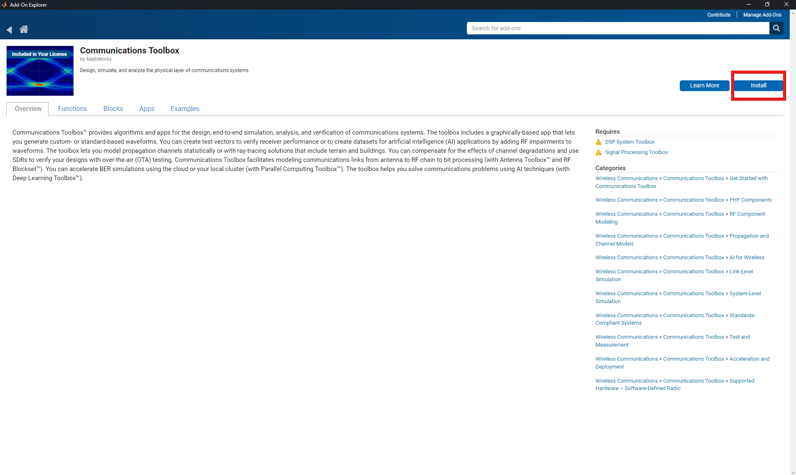
Installation Guide to Communications Toolbox in MATLAB R2025a
6. Press Install.

Slide 8
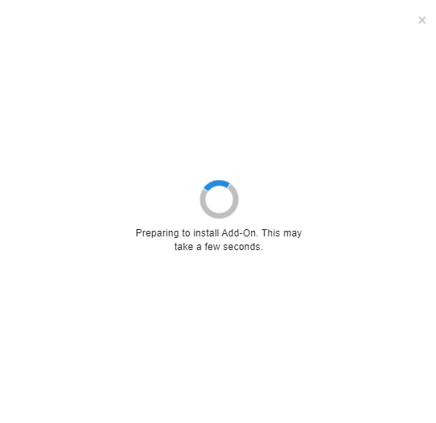
Installation Guide to Communications Toolbox in MATLAB R2025a
7. Wait a few seconds.

Slide 9
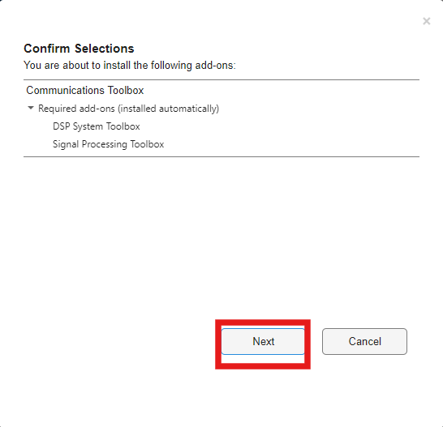
Installation Guide to Communications Toolbox in MATLAB R2025a
8. Press Next.

Slide 10
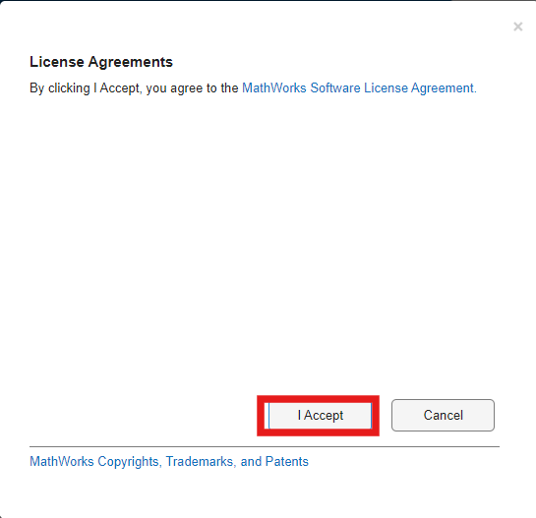
Installation Guide to Communications Toolbox in MATLAB R2025a
9. Press I Accept.

Slide 11
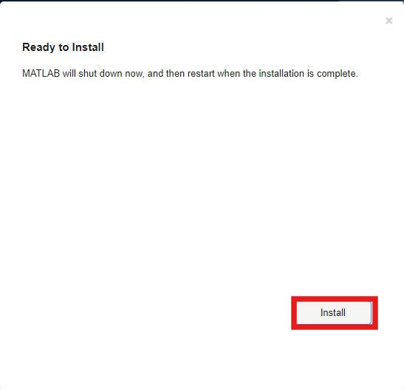
Installation Guide to Communications Toolbox in MATLAB R2025a
10. Press Install.

Slide 12
Installation Guide to Communications Toolbox in MATLAB R2025a
11. Press Install. The MATLAB desktop application will shut down on its own.

Slide 13
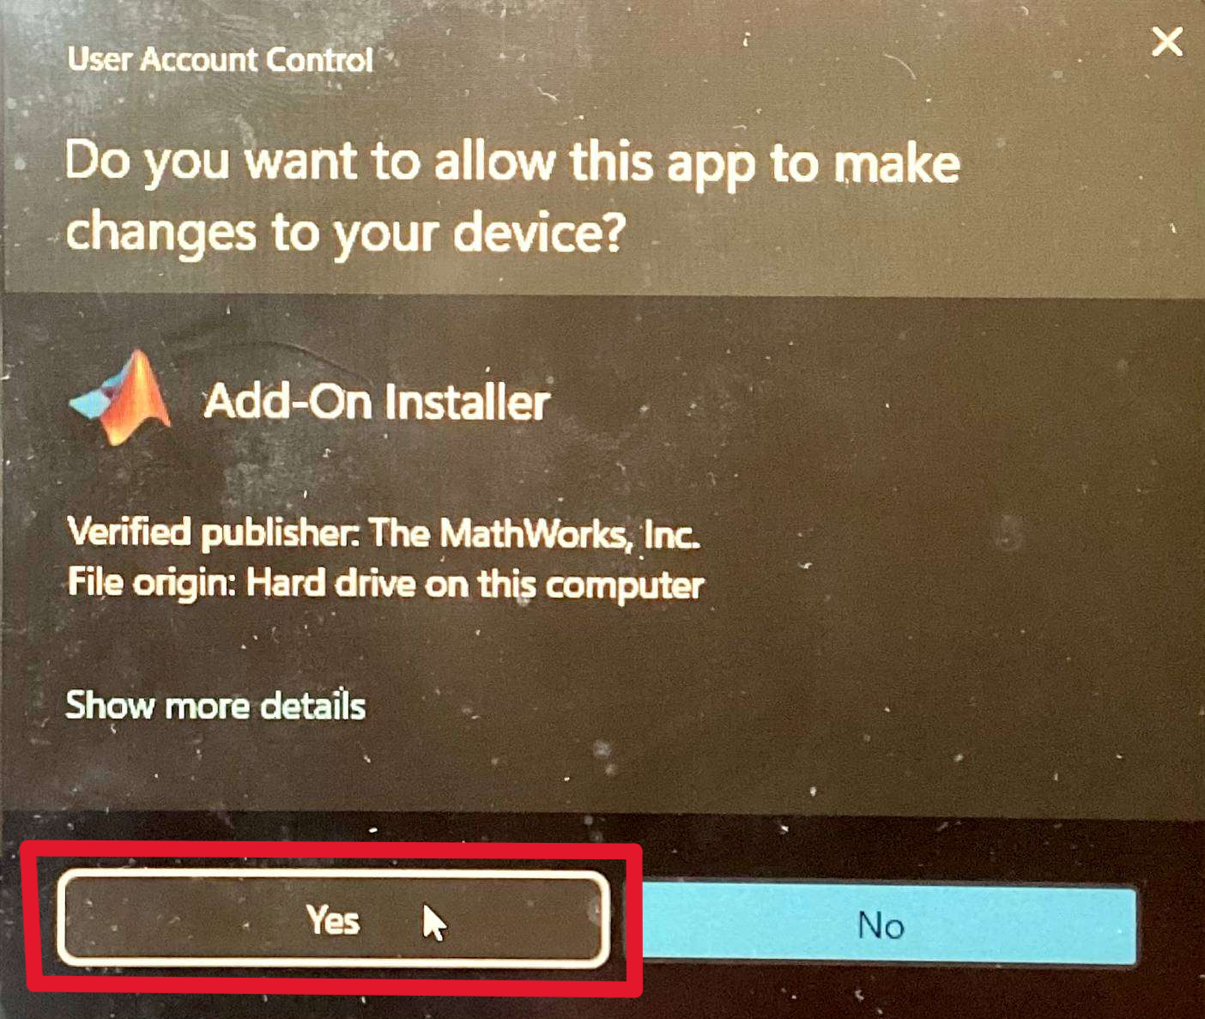
Installation Guide to Communications Toolbox in MATLAB R2025a
12. In the pop-up window of “Do you want to allow this app to make changes to your device?”, press Yes. Installation will start.
Notes:
MathWorks guide to install MATLAB: https://www.mathworks.com/help/install/ug/install-products-with-internet-connection.html

Slide 14
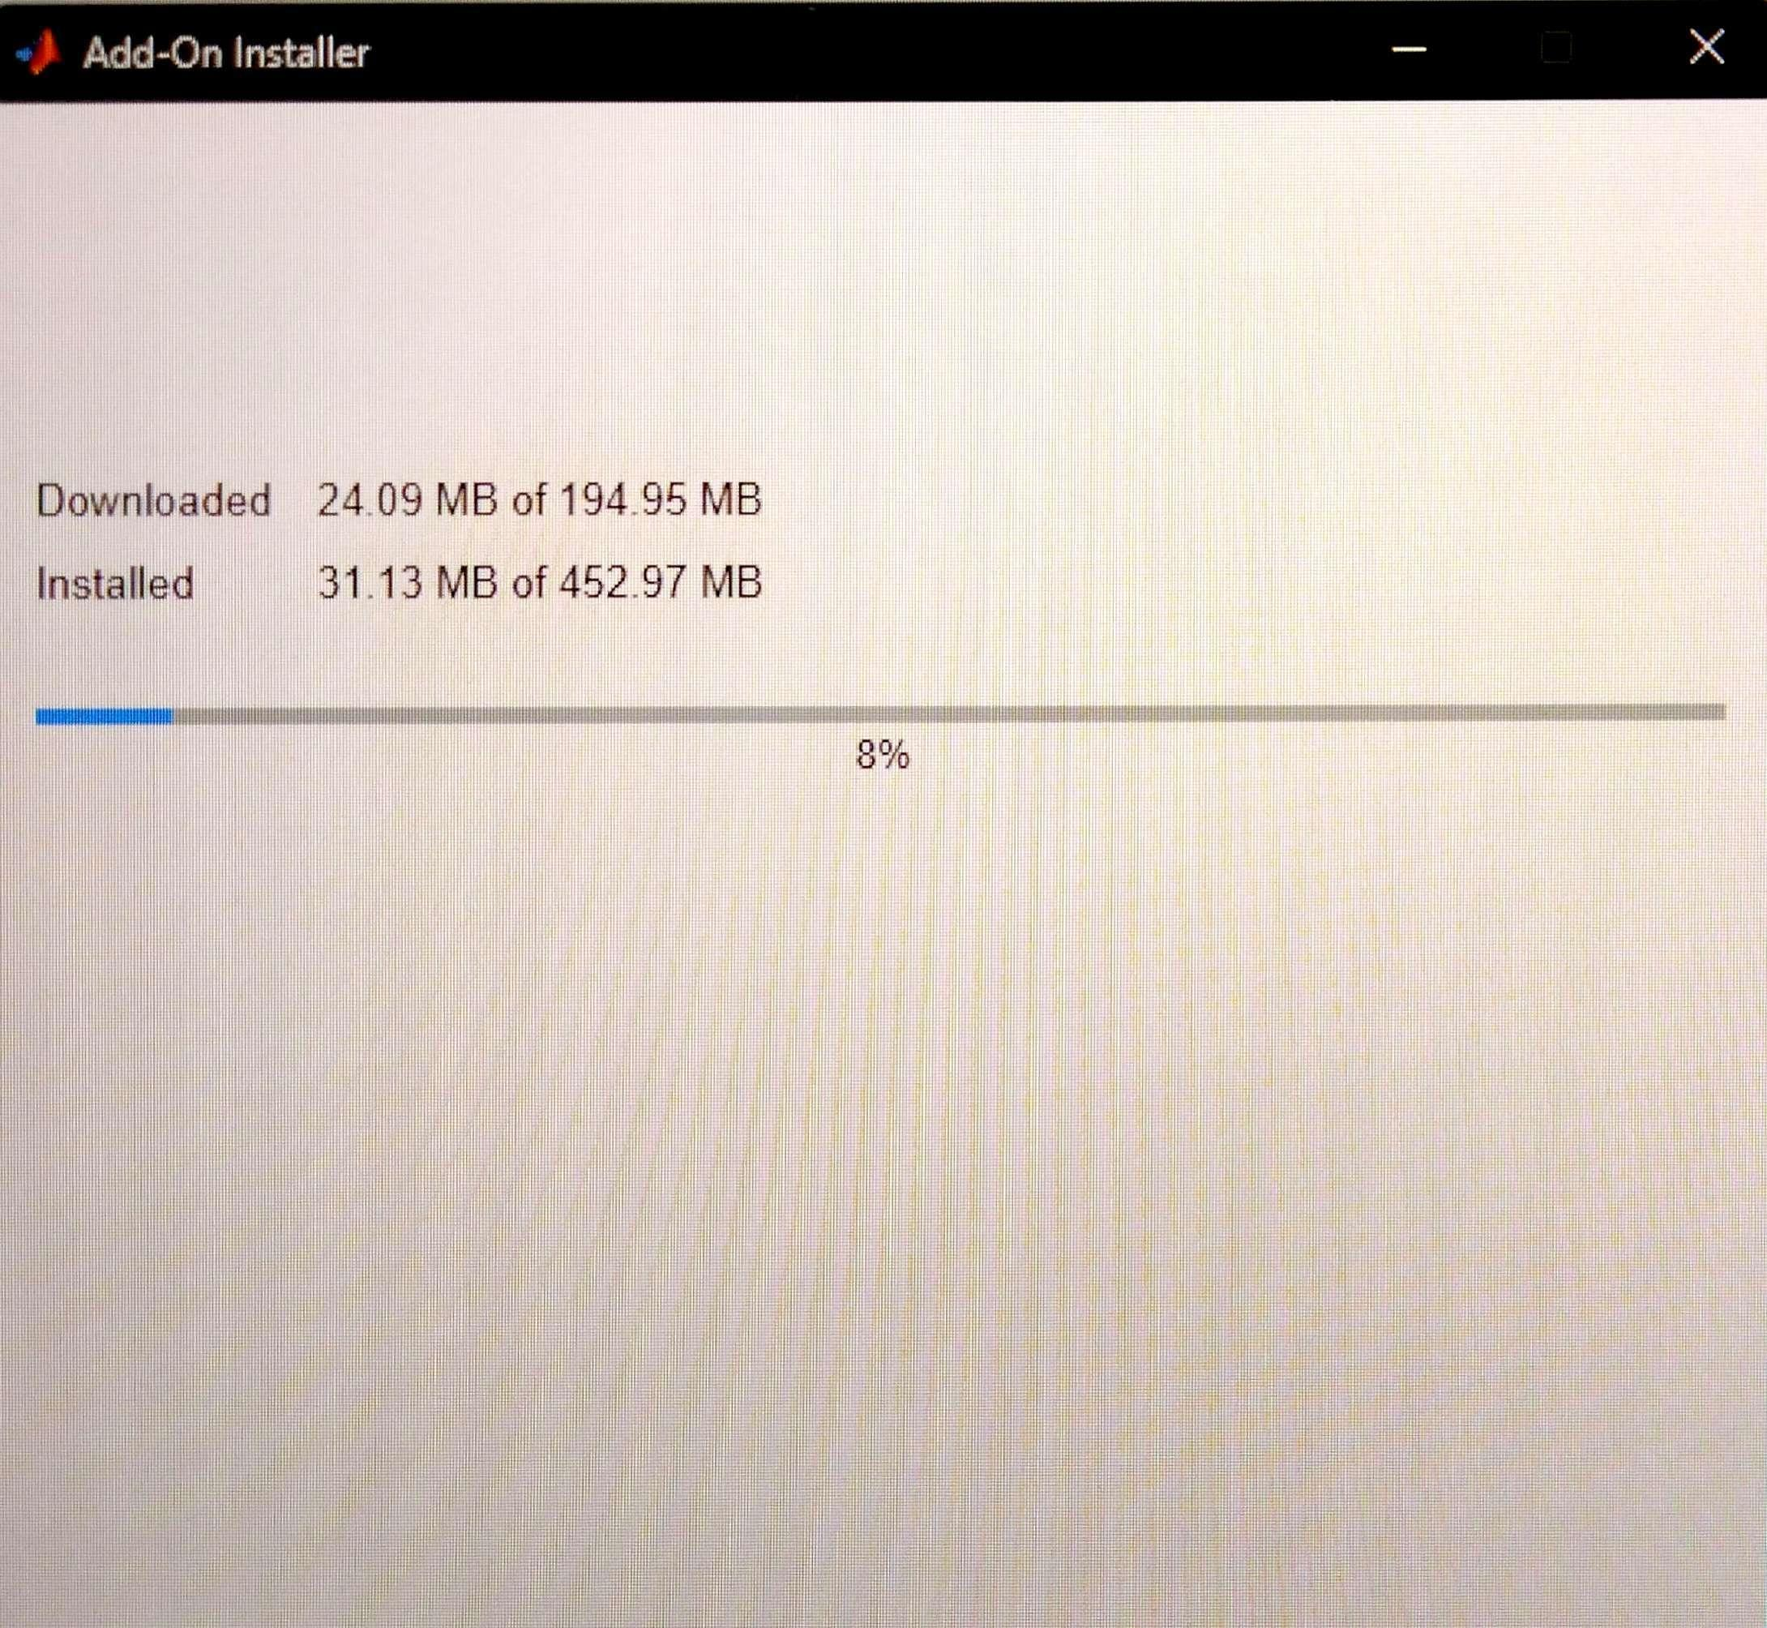
Installation Guide to Communications Toolbox in MATLAB R2025a
13. Seeing this page means the installation has successfully started and is in progress.

Slide 15
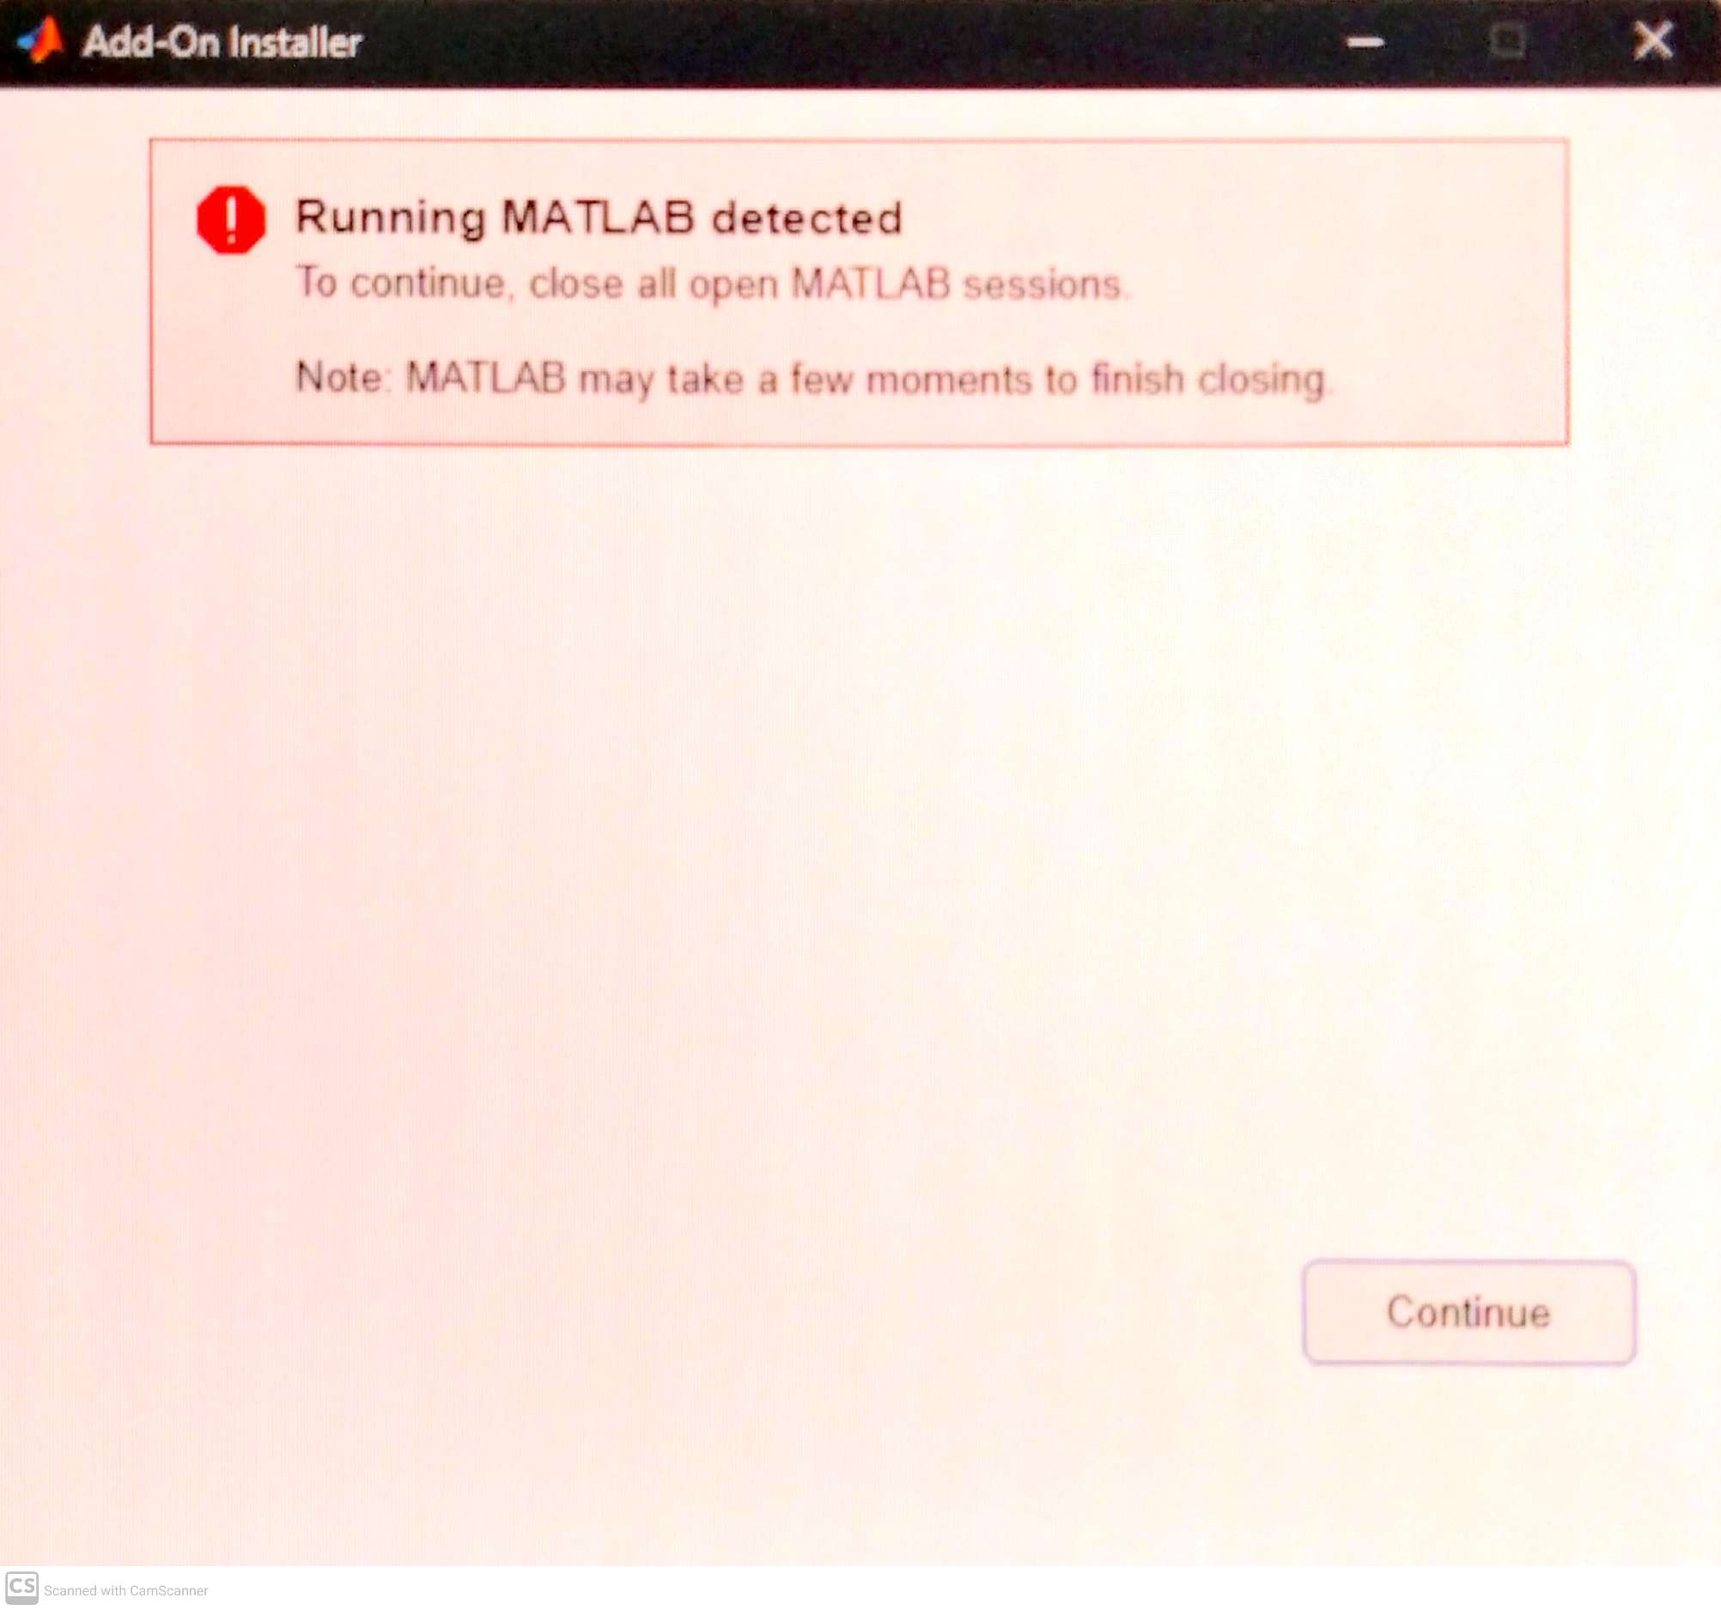
Installation Guide to Communications Toolbox in MATLAB R2025a
14. This is a common issue. Close all MATLAB sessions. Only keep the add-on explorer window open. Then, press Continue.
Notes:
MathWorks guide to install MATLAB: https://www.mathworks.com/help/install/ug/install-products-with-internet-connection.html

Slide 16
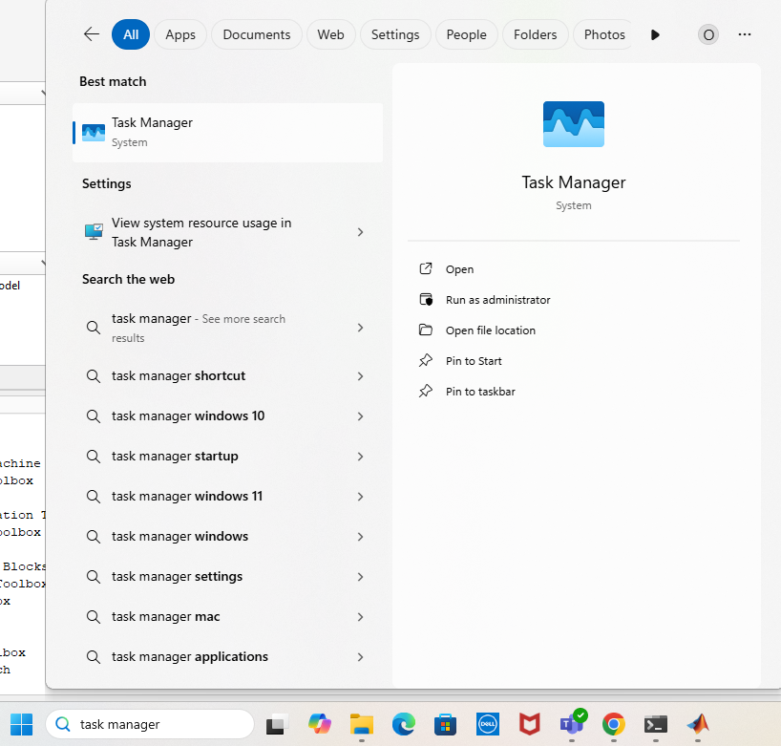
Installation Guide to Communications Toolbox in MATLAB R2025a
15. If the error persists, go to Task Manager and force stop any MATLAB session.

Slide 17
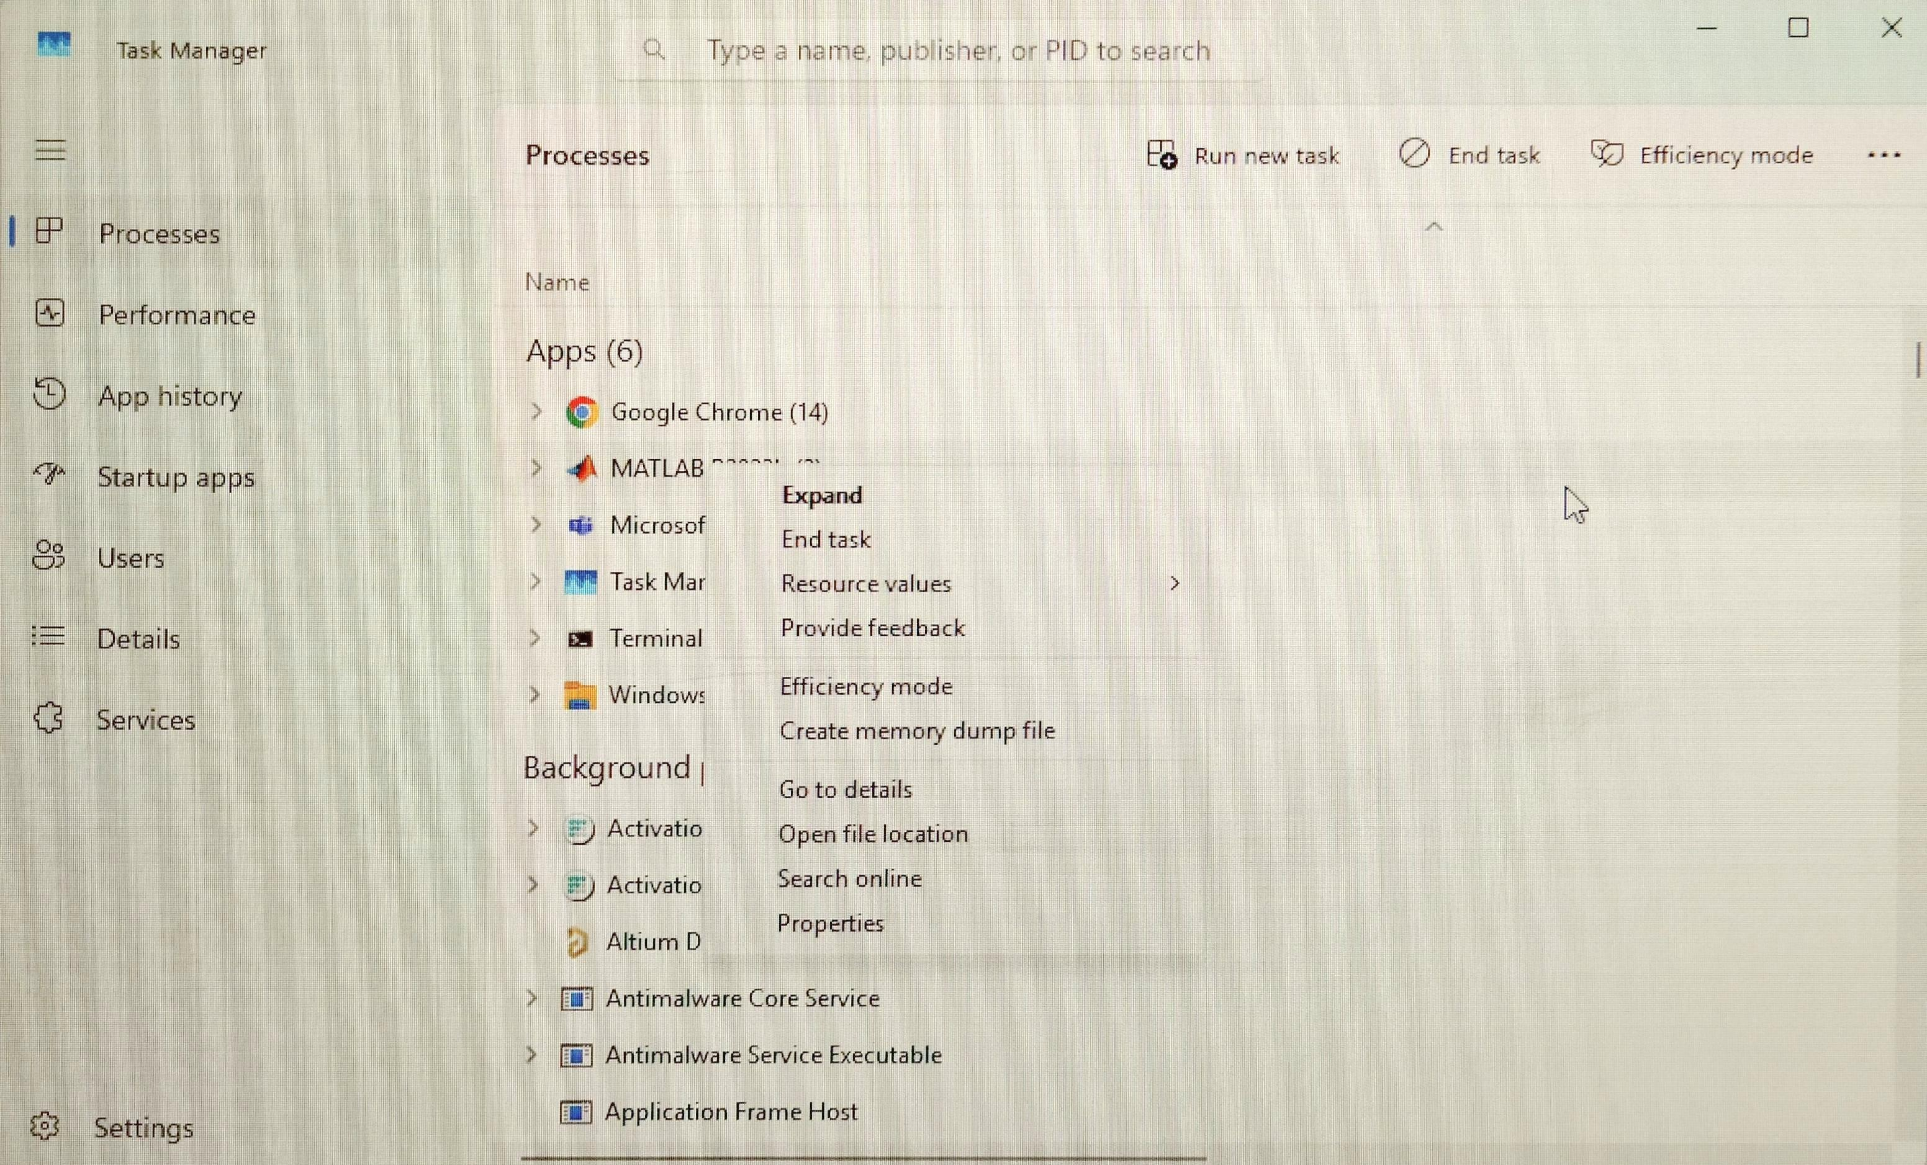
Installation Guide to Communications Toolbox in MATLAB R2025a
16. Right-click on MATLAB and then press End Task. If the issue is not resolved, restart the computer or restart the installation.

Slide 18
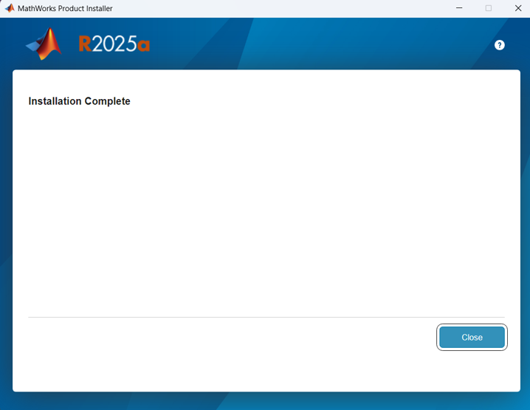
Installation Guide to Communications Toolbox in MATLAB R2025a
17. After the installation is complete, MATLAB desktop will auto restart. You may close the Installer winder now by pressing Close.

Slide 19
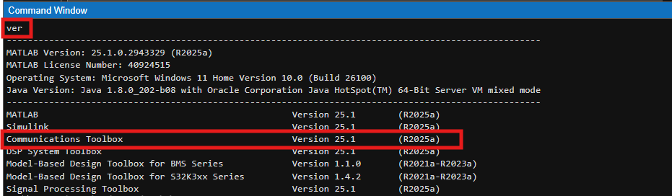
Installation Guide to Communications Toolbox in MATLAB R2025a
18. Finally, verify if Communications Toolbox is installed by using the ver command.

Slide 20
Thank you
McMaster Automotive Resource Centre (MARC)
20

